Slide 1
Issues of missing out on concerts
Research Report
Noah Unverzagt, August 1st 2025

Slide 2
Executive Summary
We conducted an interview/ survey study on how people discover concerts.
We learned…
Participants reported a lack of awareness regarding when their favorite artists were performing nearby. While they were generally informed about major artists, they were often unaware of tour dates for smaller or emerging acts.
Participants commonly learned about concerts through friends rather than through apps. While they used platforms like Bandsintown, Ticketmaster, and Spotify, word-of-mouth remained their primary source of concert information.
Participants expressed a willingness to attend concerts alone but preferred going with a group to enhance their overall experience.
Participants reported spending minimal time actively searching for concerts, instead relying on recommendations from others or discovering events through social media.

Slide 3
Overview
Background
In the United States, concertgoers reported missing certain performances due to a lack of awareness or personal connection with the artist.
My goal was to explore how concertgoers discover live events and what drives their motivation to attend.
Research Questions
What factors contribute to concertgoers missing opportunities to see artists perform?
How can we increase concertgoers' motivation to attend local performances?

Slide 4
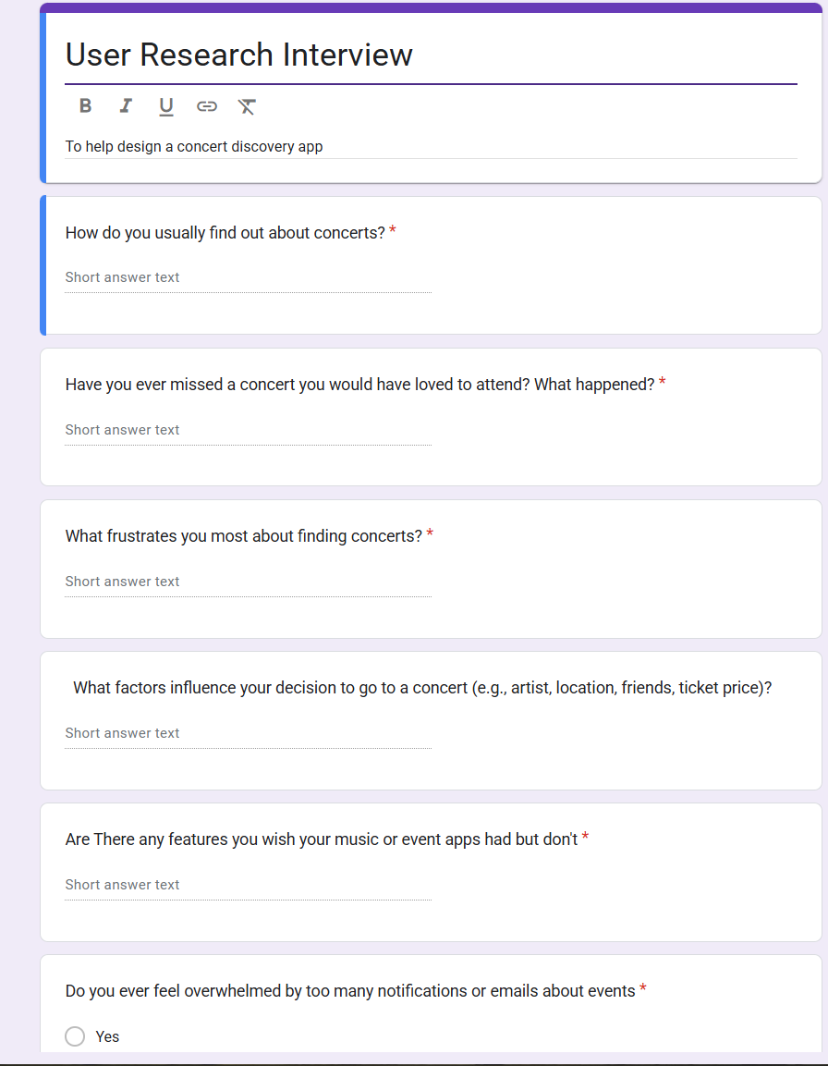
Method
I conducted a semi-structured interview and survey study over the course of one week with a diverse group of participants, ranging from avid concert enthusiasts to individuals who rarely attend concerts.
Relevant docs
User Research Google Form
Interview Questions Google Doc
Include a picture of your method here. (Interview script, survey questions, etc.)

Slide 5
Participants
 | Age | Favorite Music Genre | Number of concerts went to in the last 6 months
P1 | 25 | Indie | 6
P2 | 26 | Punk | 15
P3 | 21 | Indie | 4
P4 | 34 | Country | 2
P5 | 53 | Rock | 1

Slide 6
Findings and Recommendations

Slide 7
Finding #1
“ I’ve missed a lot of opportunities to see some of my favorite artists because I wasn’t aware they were intown.”
- P1
“I don’t find out about concerts until the day of or after.”
- P3
A large majority of people stated that they were unaware of concerts.
Surveyors stated that they would have gone to more concerts if they knew that a certain artist was performing near them or in town.

Slide 8
Finding #2
“Depending on the artist, I won’t know they are coming into town unless I accidentally stumble onto it.”
- P2
“I hardly spend any time looking for concerts. I usually find out from feed on social media”
- P4
Concertgoers do not spend a lot of time searching for concerts.
From our survey, we learned that concert goers do not spend much time looking for concerts.

Slide 9
Finding #3
“I always go to a concert with at least one friend. I have not be to a concert alone. ”
- P1
“I much rather go with a group of friends, but I will still go by myself if its an artist I really like.”
- P2
Going with a group or going alone plays a major part in if someone will go to a concert.
In our interview we discovered that people were more likely to skip a concert if they went by themselves vs if they when with another person.

Slide 10
Finding #4
“I usually hear about concerts from my friends or a social media post. ”
- P2
“My friends always text me about a concert they want to go to. I’ll usually wait for them to me.”
- P4
People hear about concerts from their friends more than they do searching.
Surveyors stated that they typically hear about concerts from their friends more often than they do from an app.

Slide 11
What’s Next?
Conduct a new survey study to better understand on what would improve discovering concerts.
Prioritize key problems to solve and create initial design ideas.

